Slide 1

CHALLENGE 7

Slide 2




TEAM
Mihai
Mohamed
John
Matt

Slide 3
Weather events have become more extreme and more detrimental over the last few years as a result of climate change. This carries a far greater risk to the safety of people on site as well as delays in the project plan and higher associated costs. In order to optimise how they delivery construction projects and how they manage assets, HS2 Ltd wants a tool that can provide real time insight into weather events so they can effectively manage decisions to optimise productivity, costs and safety.

Slide 4



USERS
Project Director
Project Manager
Site Operative
Needs
Visualise risk on a project basis
Understand where to send resource
Explain consequences of risks to stakeholders
Pain Points
Limited quantifiable evidence on projects
No golden thread of information from source
Conflicting reports from projects
Needs
Understand imminent risk
Mitigate risks by rescheduling tasks
Report risks to Client
Pain Points
Delay in receipt of data
Freak weather occurrences
Needs
Understand what can be delivered today
Reorganise teams based on achievable work
Pain Points
Sudden weather changes
Health and Safety compromised by unreasonable deliverables
Notes:
User led
Envisioned 3 key stakeholders across the delivery
Each has demands on visualisation, timeframes
One point from each
Bespoke solutions for each use case

Slide 5
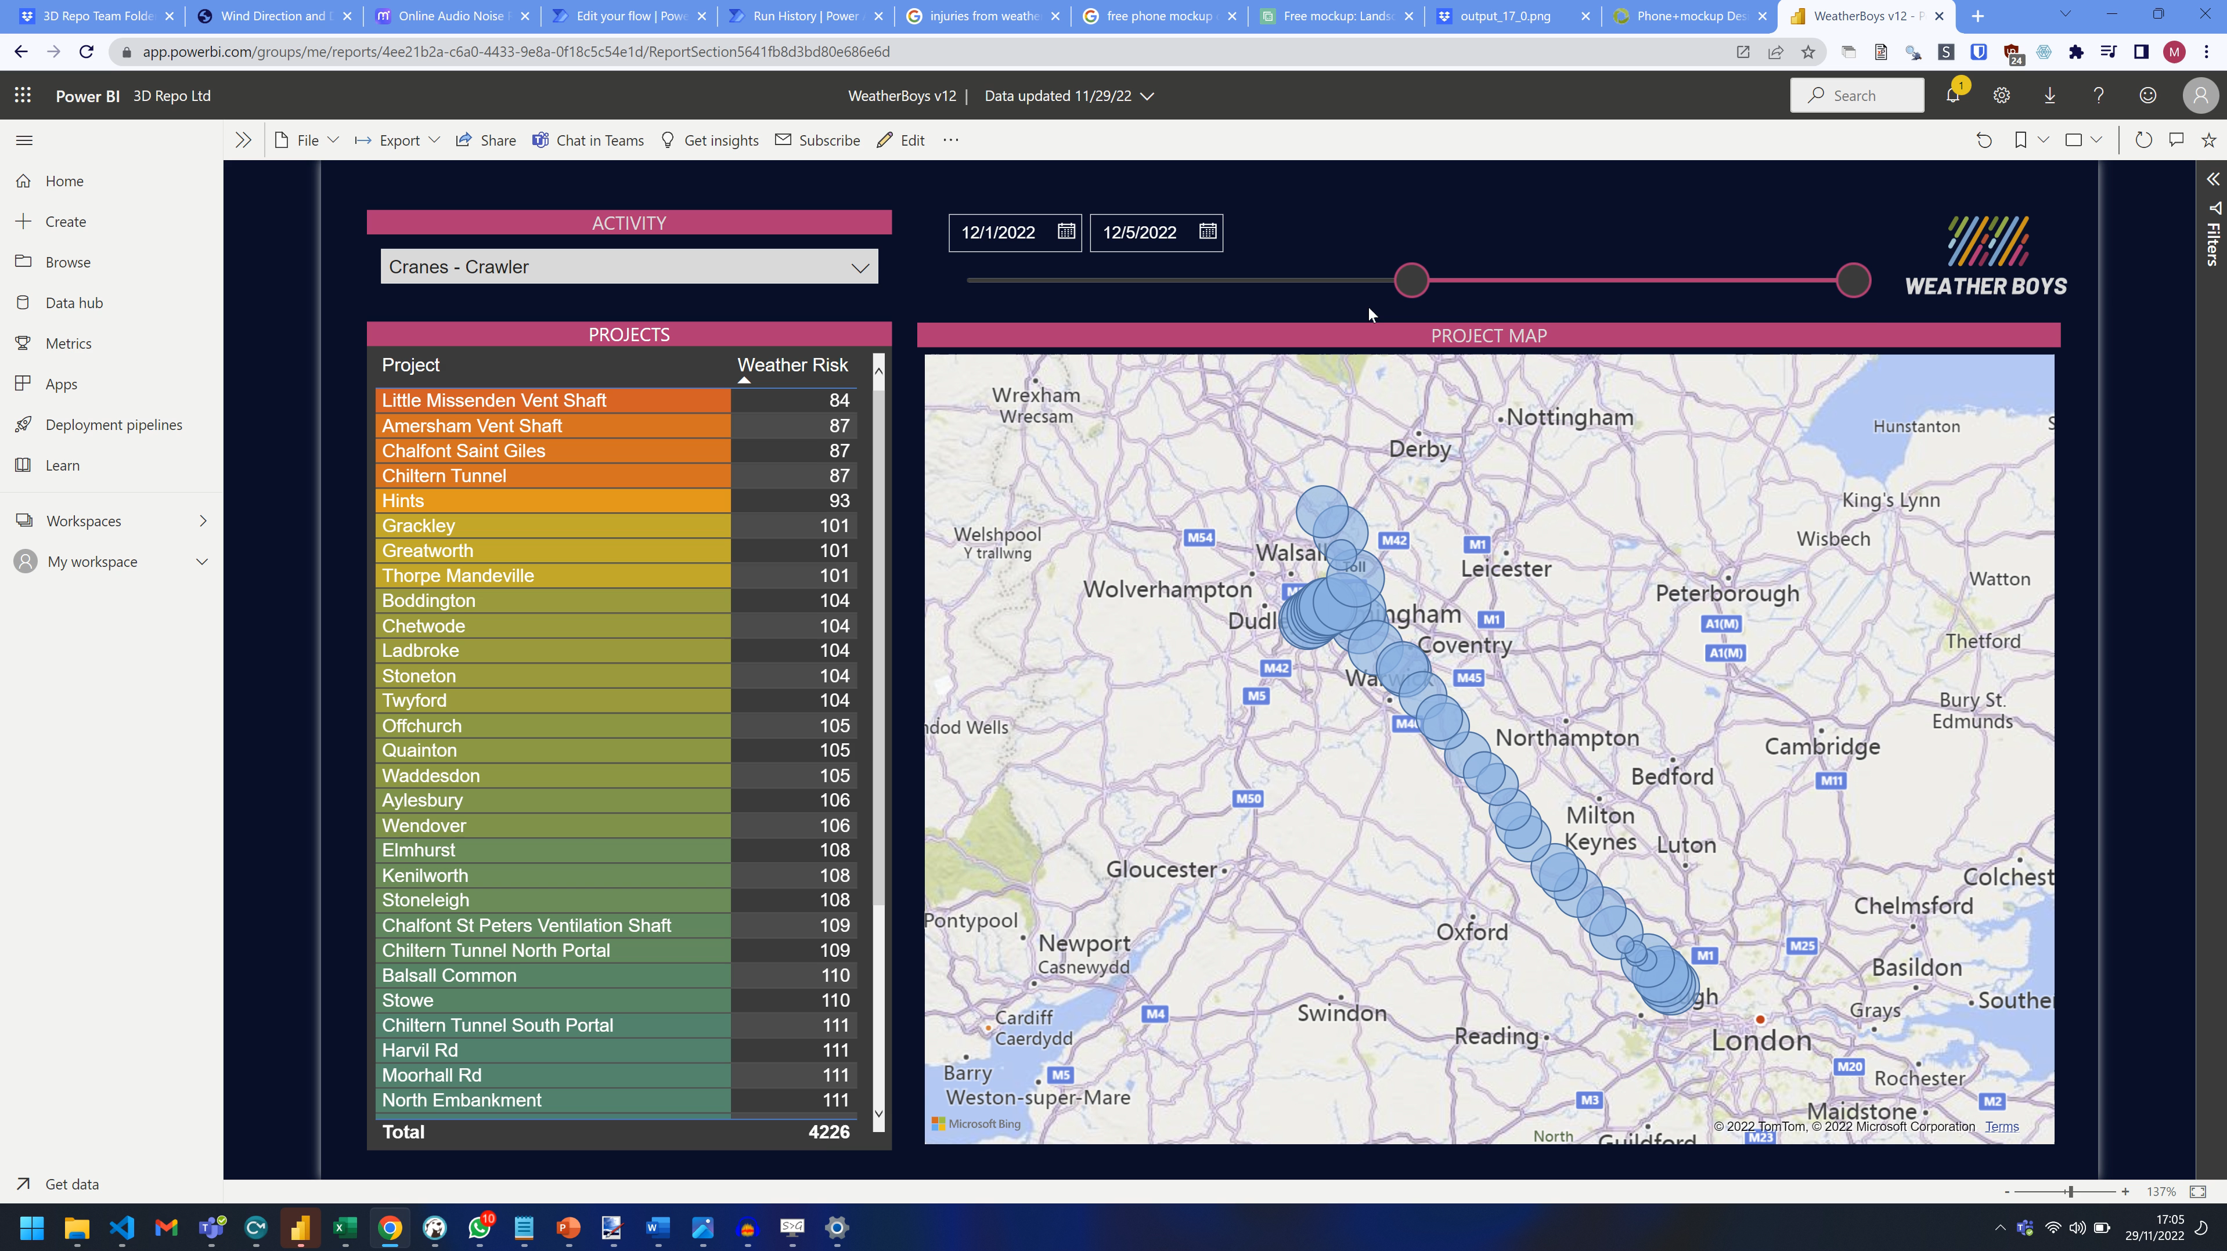
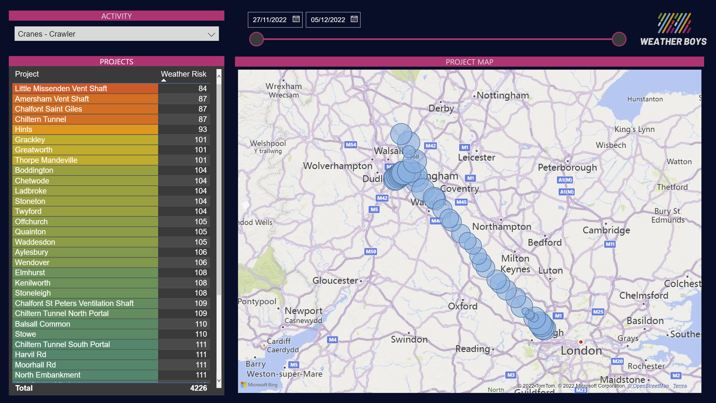
SOLUTION – PROJECT DIRECTOR
PROJECT WIDE
Amalgamate all projects across the scheme
Projects ranked by potential climate impact
INSTANT
Immediate data means instant decisions
Compatible with any size project
Notes:
High level visualisation
Early action can result in big savings
Re assign resources across project

Slide 6
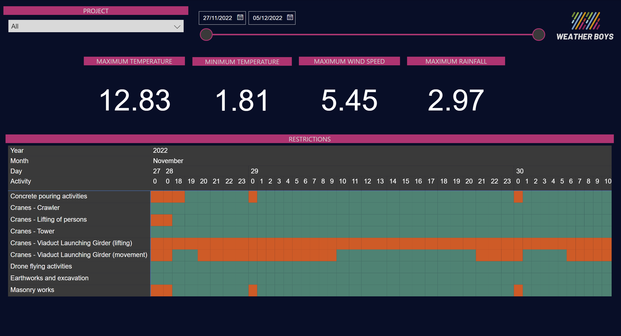
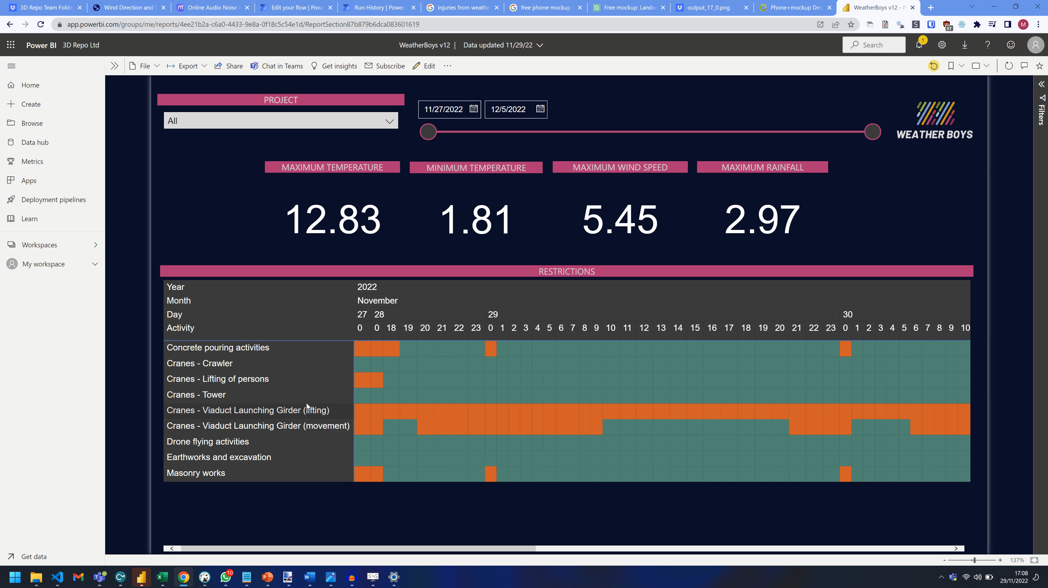
SOLUTION – PROJECT MANAGER
DETAIL
Week look ahead for short term scheduling
Identify which activities will be affected
REMEDY
Reschedule work to accommodate weather conditions
Get forewarning of potential Sub-Contract compensation events
£40,000 / week
Notes:
£200 per gang per project, with 10 gang hours saved across 20 projects each week that results in £40,000 saving per week
Understand specific impacts of weather across all project activity focussed on their particular project
Interrogate insights to expose granular data where it’s needed
Reschedule work across an individual project to deliver at optimum times
Wind speed could be directly linked to crane telemetry to alert driver when high winds predicted

Slide 7
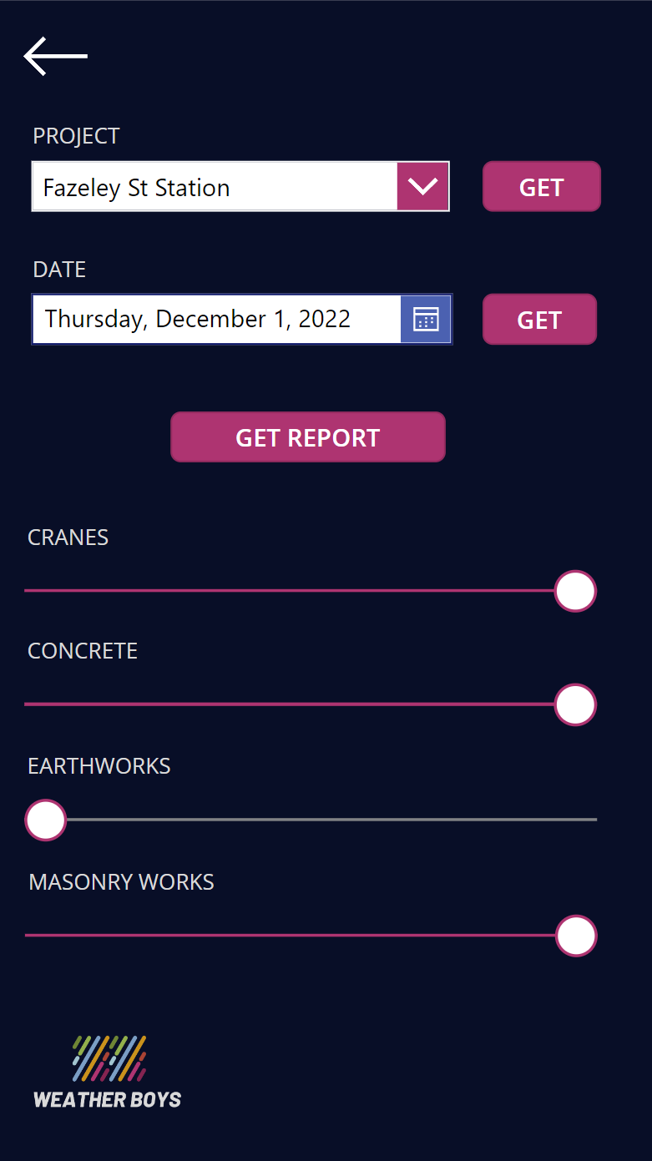
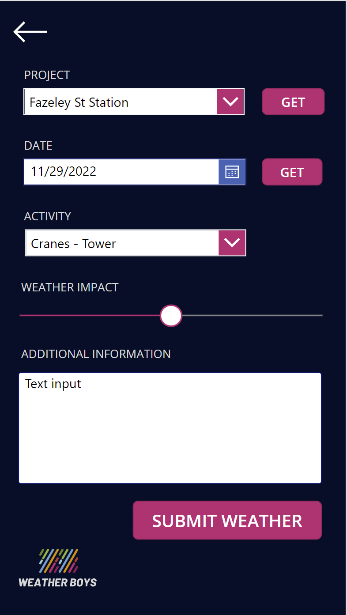
SOLUTION – SITE OPERATIVE
INSIGHT
Input work activity and planned time
Immediate go/no go based on safe weather limits
RECORD
Add observations to the app to build out a more accurate model
Understand how weather impacts site safety
Notes:
Predict a delay at the workface and plan their day around the weather
Site operative has the opportunity to record safety risks directly in the app to better enrich the existing data sources
Machine Learning could combine site observations with API data to provide more accurate predictions and mitigate risk

Slide 8
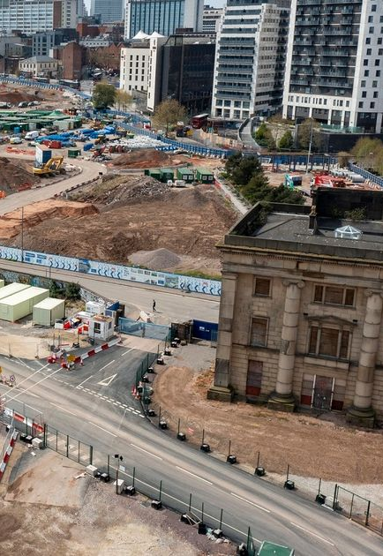
IMPLEMENTATION - TOMORROW
Feed in co-ordinates of all current project in your portfolio
Update safety requirements document
Hit refresh and go
Continued observations will enrich the data model going forward
Notes:
Given the poor condition of existing project data such as programmes, we have elected to built our platform with not data prerequisites
All you need to do is update your safety requirements so the system can understand when the weather exceeds safe levels and inform the end users

Slide 9
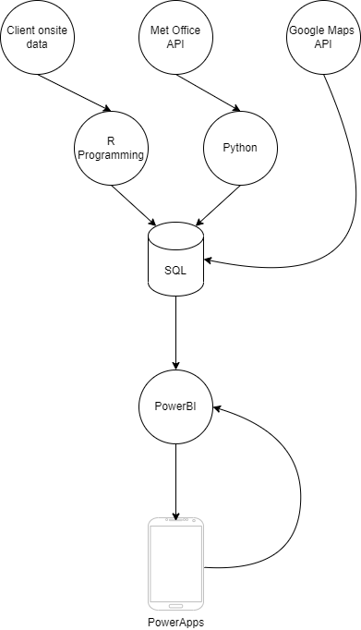
STRUCTURE
Built on SQL
Pulling data from APIs and dumb terminals via R & Python
No data pre-requisites
Additional on site weather stations will enrich data
Notes:
Data has been compiled using open standards, combining provided site data with data from the Met Office API
Built with the expectation that this would be an ongoing automated system, live projects can run scripts daily to populate the database
Every additional on site weather station will create a more accurate solution

Slide 10
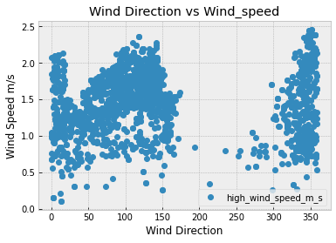
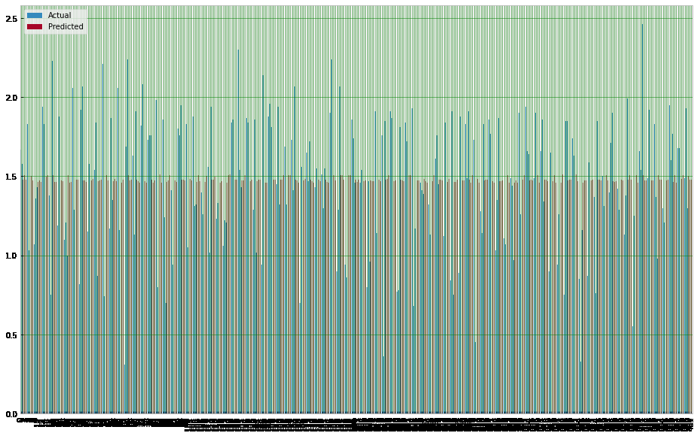
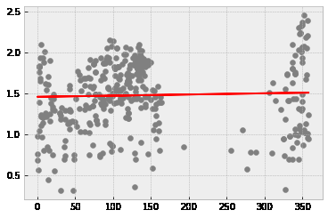
MACHINE LEARNING
Adapt to different seasons
Increase accuracies over time
Room to grow

Slide 11
QUESTIONS
How have you managed combining data from different sources?
How would the system deal with a big difference in weather data from the met office and the onsite sensors?
Would it be easy for a new site to be added to the dashboard in the future? What would the process for this be?

Slide 12
QUESTIONS
1. How have you managed combining data from different sources?
Met Office Data via API
Onsite data through R
Latitude and Longitude from HS2 map

Slide 13
QUESTIONS
2. How would the system deal with a big difference in weather data from the met office and the onsite sensors?
Self Reported weather from on site
Time will tell reliability

Slide 14
QUESTIONS
3. Would it be easy for a new site to be added to the dashboard in the future? What would the process for this be?
Integrate with Project Management System
R Process continually rerun

